Slide 1
Domain ML
Technology: Python
MACHINE LEARNING-BASED ANALYSIS OF CRYPTO CURRENCY MARKET FINANCIAL RISK MANAGEMENT

Slide 2
ABSTRACT
Crypto currency is a well-known financial state in the globe, posing a variety of dangers that have an impact on the intrinsic risk assessment of risk auditors. Since its inception, the rise of crypto currencies has presented financial institutions with a wide range of risks in terms of money laundering. In the institution of financial supports such as anti-money laundering, banks, and bank secrecy, continue as a risk specialist, bank manager, and compliance officer who has a provocation for the connected transaction through crypto currencies and the users who conceal the illicit funds. In this study, the crypto currency framework was subjected to Hierarchical Risk Parity and unsupervised machine learning. The professional accounting procedure in terms of the inherent risk associated with bit-coin. The professional crypto currency experience in transaction cause the lower risk comparing the less experienced one. The Hierarchical Risk Parity gives the better output in term of returning the adjusted risk tail to get the better risk management result. The result section shows the proposed model is robust to various intervals which are re-balanced and the co-variance window estimation.

Slide 3
INTRODUCTION
Financial market is one of the complex systems that the definition of complexity didn’t get accepted from universities and this cause the agreement in term of interacting the elements of complex systems together. Complex system modeling is similar to daunting task which the structure of this system organized based on hierarchical manner that collected their own subsystems [1]–[3]. This resources extracted by the name of hierarchical models. Unfortunately, in the process of portfolio construction there is a hug challenge regarding the lack of correlation matrix in hierarchical structure. This issue worsen the matrices for large covariance. In recent decades, around 2500 type of cryptocurrencies which contains the 252.5 trillion dollar of trading in this market [4]–[6]. The cryptocurrency reverberation transpire in, out of order environment [7]–[10]. Even news publishers had more interest and closer attention to the price changes and the large remote of actions to the soar unmitigated. Rules set up is for investors protecting and try to stop the money laundry. Similarly, stop the crowd for the fiat currency. Regarding all the mentioned good wills, implementation and theories shows the dedicated movement of price of cryptocurrency market. Lahre et al.

Slide 4
Markowitz optimization with the high ratio. Walid et al. [15] proposed the relationship between cryptocurrencies based on the highest frequency. The presented system gives the output of useful marketing insights and gives the allowance to the agent to improve the system stability. Platanakis et al. [16], demonstrates the estimation error in term of return estimation rather than naively diversified (1/N) strategy. Similarly, they used [17] the model of Black Litterman based on the variance constraints to support the sophisticated portfolio technique for estimation control of the simple methods to manage the cryptocurrency. Saba et al. [18] applied the wavelet-based analysis for cryptocurrency multi-scale dynamic interdependence between the liquid cryptocurrencies to count the traders and investors heterogeneous behaviour. Corbet et al. [19] compare the different rules of trading in term of average-oscillator to breakout the range of trading strategies. Based on the reports of cryptocurrency related audit considerations and Chartered Professional Accountants Cananda (CPAC), building the general awareness for the intrinsic risks of the ecosystem of digital assets recommended. I

Slide 5

Literature survey:
S. No | Journal Type with year | Authors | Title | Outcomes
1 | Conference ICT, Jan. 2018, pp. 1–6. | C. Y. Kim and K. Lee, | ‘‘Risk management to cryptocurrency exchange and investors guidelines to prevent potential threats,’’ | Investment and interest in cryptocurrency
2 | Conference , vol. 9, no. 9, p. 163, Sep. 2021 | ]. I. U. Haq, A. Maneengam, S. Chupradit, W. Suksatan, and C. Huo | ‘‘Economic policy uncertainty and cryptocurrency market as a risk management avenue: A systematic review,’’ | Cryptocurrency literature
3 | ” Conference , vol. 68, no. 3, pp. 12–13, 2021 | J. Gold and S. D. Palley | ‘‘Protecting cryptocurrency assets,’’ | cryptocurrency wallets
4 | Conference vol. 24, no. 1, pp. 95–118, Jun. 2021. | I. Barkai, T. Shushi, and R. Yosef | ‘‘A cryptocurrency risk–return analysis for bull and bear regimes,’’ | bitcoin, litecoin, ripple, and ethereum

Slide 6
EXISTING SYSTEM
In the existing system, implementation of machine learning algorithms is bit complex to build due to the lack of information about the data visualization. The RL was compared to existing research works and the most frequent benchmarks in this area, the two management portfolio algorithms and the basic DQN of the trading system. In terms of bit-coin risk management, the proposed RL algorithms are compared to other existing studies. To overcome all this, we use machine learning packages available in the scikit-learn library.
Disadvantages:
High complexity.
Time consuming.

Slide 7
PROPOSED SYSTEM
Proposed several machine learning models to classify machine learning-based analysis of crypto currency market financial risk management. Also, similar studies that have proposed models for evaluation of such performance .Therefore, we propose a Decision tree, Random Forest, MLP Classifier, Ada boost , Extra tree Classifier to predict the risks.
Advantages:
Highest accuracy
Reduces time complexity.
Easy to use

Slide 8
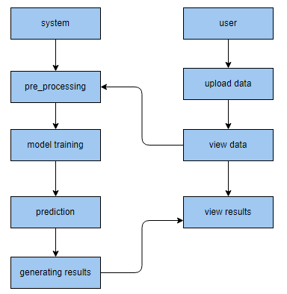
PROPOSED METHOD

Slide 9
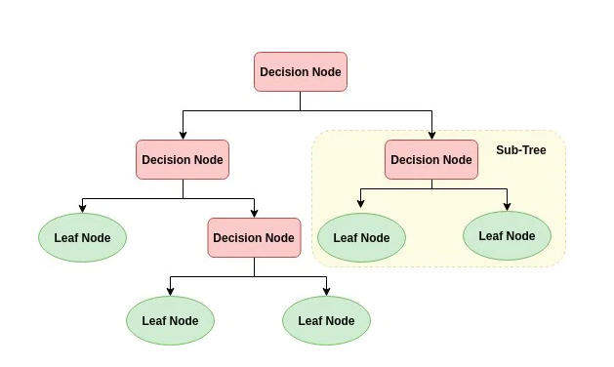
ALGORITHMS
Decision Tree:
Decision tree is a flowchart-like tree structure where an internal node represents feature(or attribute), the branch represents a decision rule, and each leaf node represents the outcome. The topmost node in a decision tree is known as the root node. It learns to partition on the basis of the attribute value. It partitions the tree in recursively manner call recursive partitioning. This flowchart-like structure helps you in decision making. It's visualization like a flowchart diagram which easily mimics the human level thinking. That is why decision trees are easy to understand and interpret.

Slide 10
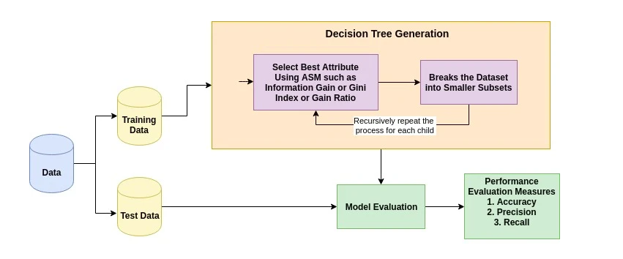
The basic idea behind any decision tree algorithm is as follows:
Select the best attribute using Attribute Selection Measures (ASM) to split the records.
Make that attribute a decision node and breaks the dataset into smaller subsets.
Starts tree building by repeating this process recursively for each child until one of the conditions will match:
All the tuples belong to the same attribute value.
There are no more remaining attributes.
There are no more instances.

Slide 11
2. RANDOM FOREST CLASSIFIER:
A random forest is a machine learning technique that’s used to solve regression and classification problems. It utilizes ensemble learning, which is a technique that combines many classifiers to provide solutions to complex problems.
A random forest algorithm consists of many decision trees. The ‘forest’ generated by the random forest algorithm is trained through bagging or bootstrap aggregating. Bagging is an ensemble meta-algorithm that improves the accuracy of machine learning algorithms.
The (random forest) algorithm establishes the outcome based on the predictions of the decision trees. It predicts by taking the average or mean of the output from various trees. Increasing the number of trees increases the precision of the outcome.
A random forest eradicates the limitations of a decision tree algorithm. It reduces the over fitting of datasets and increases precision. It generates predictions without requiring many configurations in packages (like Scikit-learn).

Slide 12
Features of a Random Forest Algorithm:
It’s more accurate than the decision tree algorithm.
It provides an effective way of handling missing data.
It can produce a reasonable prediction without hyper-parameter tuning.
It solves the issue of over fitting in decision trees.
In every random forest tree, a subset of features is selected randomly at the node’s splitting point.
Decision trees are the building blocks of a random forest algorithm. A decision tree is a decision support technique that forms a tree-like structure. An overview of decision trees will help us understand how random forest algorithms work.
A decision tree consists of three components: decision nodes, leaf nodes, and a root node. A decision tree algorithm divides a training dataset into branches, which further segregate into other branches. This sequence continues until a leaf node is attained. The leaf node cannot be segregated further.
The nodes in the decision tree represent attributes that are used for predicting the outcome. Decision nodes provide a link to the leaves. The following diagram shows the three types of nodes in a decision tree.

Slide 13
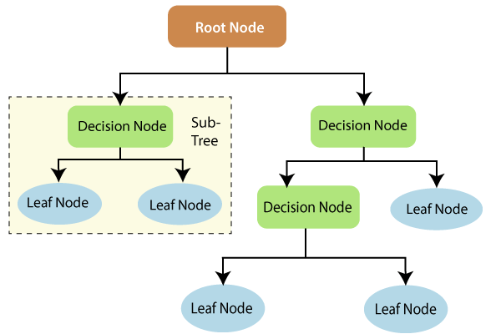
The information theory can provide more information on how decision trees work. Entropy and information gain are the building blocks of decision trees. An overview of these fundamental concepts will improve our understanding of how decision trees are built.
Entropy is a metric for calculating uncertainty. Information gain is a measure of how uncertainty in the target variable is reduced, given a set of independent variables.
The information gain concept involves using independent variables (features) to gain information about a target variable (class). The entropy of the target variable (Y) and the conditional entropy of Y (given X) are used to estimate the information gain. In this case, the conditional entropy is subtracted from the entropy of Y.

Slide 14
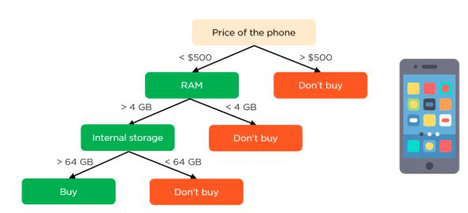
Information gain is used in the training of decision trees. It helps in reducing uncertainty in these trees. A high information gain means that a high degree of uncertainty (information entropy) has been removed. Entropy and information gain are important in splitting branches, which is an important activity in the construction of decision trees.
Let’s take a simple example of how a decision tree works. Suppose we want to predict if a customer will purchase a mobile phone or not. The features of the phone form the basis of his decision. This analysis can be presented in a decision tree diagram.
The root node and decision nodes of the decision represent the features of the phone mentioned above. The leaf node represents the final output, either buying or not buying. The main features

Slide 15
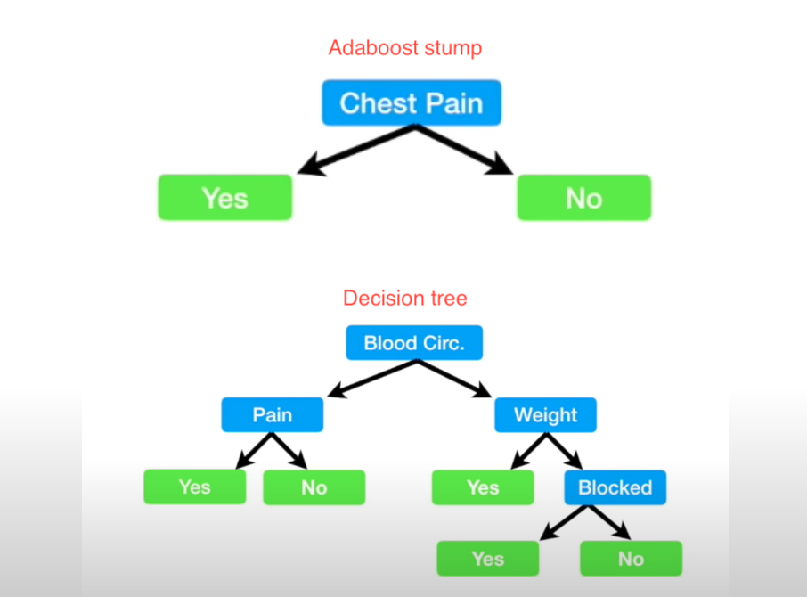
3.AdaBoost Algorithm:
AdaBoost also called Adaptive Boosting is a technique in Machine Learning used as an Ensemble Method. The most common algorithm used with AdaBoost is decision trees with one level that means with Decision trees with only 1 split. These trees are also called Decision Stumps.

Slide 16
AdaBoost algorithm, short for Adaptive Boosting, is a Boosting technique used as an Ensemble Method in Machine Learning. It is called Adaptive Boosting as the weights are re-assigned to each instance, with higher weights assigned to incorrectly classified instances. Boosting is used to reduce bias as well as variance for supervised learning. It works on the principle of learners growing sequentially. Except for the first, each subsequent learner is grown from previously grown learners. In simple words, weak learners are converted into strong ones. The AdaBoost algorithm works on the same principle as boosting with a slight difference. Let’s discuss this difference in detail.
Let us discuss how boosting works. It makes ‘n’ number of decision trees during the data training period. As the first decision tree/model is made, the incorrectly classified record in the first model is given priority. Only these records are sent as input for the second model. The process goes on until we specify a number of base learners we want to create. Remember, repetition of records is allowed with all boosting techniques. These data science challenges give a global forum for learning, researching, and solving corporate and government problems. Boosting algorithms combine many low accuracy (weak) models to produce high accuracy (strong) models. It may be used in a variety of fields, including credit, insurance, marketing, and sales. Machine learning techniques such as AdaBoost, Gradient Boosting, and XGBoost are extensively utilized to win data science contests. In this course, you will learn about the AdaBoost ensemble boosting method.

Slide 17
EXTRA TREES CLASSIFIER:
(Extra Trees Classifier) is a type of ensemble learning technique which aggregates the results of multiple de-correlated decision trees collected in a “forest” to output it’s classification result. In concept, it is very similar to a Random Forest Classifier and only differs from it in the manner of construction of the decision trees in the forest.
Each Decision Tree in the Extra Trees Forest is constructed from the original training sample. Then, at each test node, Each tree is provided with a random sample of k features from the feature-set from which each decision tree must select the best feature to split the data based on some mathematical criteria (typically the Gini Index). This random sample of features leads to the creation of multiple de-correlated decision trees.
To perform feature selection using the above forest structure, during the construction of the forest, for each feature, the normalized total reduction in the mathematical criteria used in the decision of feature of split (Gini Index if the Gini Index is used in the construction of the forest) is computed. This value is called the Gini Importance of the feature. To perform feature selection, each feature is ordered in descending order according to the Gini Importance of each feature and the user selects the top k features according to his/her choice.

Slide 18
Extra trees (short for extremely randomized trees) is an ensemble supervised machine learning method that uses decision trees and is used by the Train Using AutoML tool. See Decision trees classification and regression algorithm for information about how decision trees work. This method is similar to random forests but can be faster.
The extra trees algorithm, like the random forests algorithm, creates many decision trees, but the sampling for each tree is random, without replacement. This creates a dataset for each tree with unique samples. A specific number of features, from the total set of features, are also selected randomly for each tree. The most important and unique characteristic of extra trees is the random selection of a splitting value for a feature. Instead of calculating a locally optimal value using Gini or entropy to split the data, the algorithm randomly selects a split value. This makes the trees diversified and uncorrelated.

Slide 19
MULTILAYER PERCEPTRON:
In the world of deep learning, TensorFlow, Keras, Microsoft Cognitive Toolkit (CNTK), and PyTorch are very popular. Most of us may not realise that the very popular machine learning library Scikit-learn is also capable of a basic deep learning modelling
Salient points of Multilayer Perceptron (MLP) in Scikit-learn
There is no activation function in the output layer.
For regression scenarios, the square error is the loss function, and cross-entropy is the loss function for the classification
It can work with single as well as multiple target values regression.
Unlike other popular packages, likes Keras the implementation of MLP in Scikit doesn’t support GPU.
We cannot fine-tune the parameters like different activation functions, weight initializers etc. for each layer.
A multilayer perceptron (MLP) is a class of feedforward artificial neural network (ANN). The term MLP is used ambiguously, sometimes loosely to mean any feedforward ANN, sometimes strictly to refer to networks composed of multiple layers of perceptrons (with threshold activation); see § Terminology. Multilayer perceptrons are sometimes colloquially referred to as "vanilla" neural networks, especially when they have a single hidden layer.

Slide 20
An MLP consists of at least three layers of nodes: an input layer, a hidden layer and an output layer. Except for the input nodes, each node is a neuron that uses a nonlinear activation function. MLP utilizes a supervised learning technique called backpropagation for training.[2][3] Its multiple layers and non-linear activation distinguish MLP from a linear perceptron. It can distinguish data that is not linearly separable
The term "multilayer perceptron" does not refer to a single perceptron that has multiple layers. Rather, it contains many perceptrons that are organized into layers. An alternative is "multilayer perceptron network". Moreover, MLP "perceptrons" are not perceptrons in the strictest possible sense. True perceptrons are formally a special case of artificial neurons that use a threshold activation function such as the Heaviside step function. MLP perceptrons can employ arbitrary activation functions. A true perceptron performs binary classification, an MLP neuron is free to either perform classification or regression, depending upon its activation function.
The term "multilayer perceptron" later was applied without respect to nature of the nodes/layers, which can be composed of arbitrarily defined artificial neurons, and not perceptrons specifically. This interpretation avoids the loosening of the definition of "perceptron" to mean an artificial neuron in general.

Slide 21
HARDWARE AND SOFTWARE REQUIREMENTS
H/W Configuration:
Operating system : Windows 7 or 7+
RAM : 8 GB
Hard disc or SSD : More than 500 GB
Processor : Intel 3rd generation or high or Ryzen with 8 GB Ram
S/W Configuration:
Software’s : Python 3.6 or high version
IDE : PyCharm.
Framework : Flask, pandas, numpy and Scikit-Learn

Slide 22
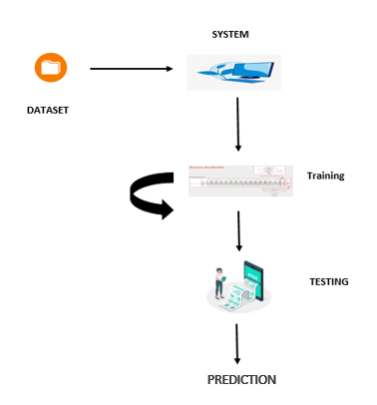
ARCHITECTURE:

Slide 23
UML DIAGRAMS
UML stands for Unified Modelling Language. UML is a standardized general-purpose modelling language in the field of object-oriented software engineering. The standard is managed, and was created by, the Object Management Group.
The goal is for UML to become a common language for creating models of object-oriented computer software. In its current form UML is comprised of two major components: a Meta-model and a notation. In the future, some form of method or process may also be added to; or associated with, UML.
The Unified Modelling Language is a standard language for specifying, Visualization, Constructing and documenting the artefacts of software system, as well as for business modelling and other non-software systems. The UML represents a collection of best engineering practices that have proven successful in the modelling of large and complex systems.
The UML is a very important part of developing objects-oriented software and the software development process. The UML uses mostly graphical notations to express the design of software projects.

Slide 24
GOALS:
The Primary goals in the design of the UML are as follows:
Provide users a ready-to-use, expressive visual modelling Language so that they can develop and exchange meaningful models.
Provide extendibility and specialization mechanisms to extend the core concepts.
Be independent of particular programming languages and development process.
Provide a formal basis for understanding the modelling language.
Encourage the growth of OO tools market.
Support higher level development concepts such as collaborations, frameworks, patterns and components.
Integrate best practices.

Slide 25
USE CASE DIAGRAM
A use case diagram in the Unified Modeling Language (UML) is a type of behavioral diagram defined by and created from a Use-case analysis.
Its purpose is to present a graphical overview of the functionality provided by a system in terms of actors, their goals (represented as use cases), and any dependencies between those use cases.
The main purpose of a use case diagram is to show what system functions are performed for which actor. Roles of the actors in the system can be depicted.

Slide 26
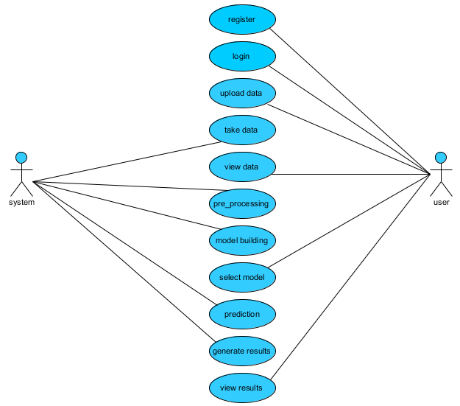

Slide 27
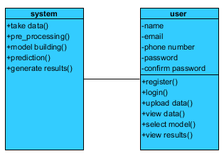
CLASS DIAGRAM
In software engineering, a class diagram in the Unified Modeling Language (UML) is a type of static structure diagram that describes the structure of a system by showing the system's classes, their attributes, operations (or methods), and the relationships among the classes. It explains which class contains information

Slide 28
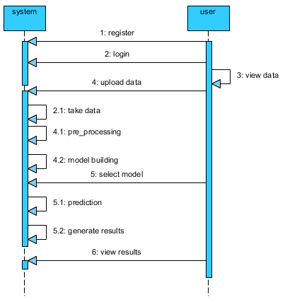
SEQUENCE DIAGRAM
A sequence diagram in Unified Modeling Language (UML) is a kind of interaction diagram that shows how processes operate with one another and in what order.
It is a construct of a Message Sequence Chart. Sequence diagrams are sometimes called event diagrams, event scenarios, and timing diagrams

Slide 29
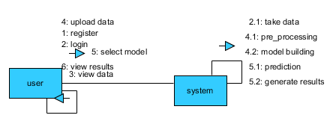
COLLABORATION DIAGRAM:
In collaboration diagram the method call sequence is indicated by some numbering technique as shown below. The number indicates how the methods are called one after another. We have taken the same order management system to describe the collaboration diagram. The method calls are similar to that of a sequence diagram. But the difference is that the sequence diagram does not describe the object organization whereas the collaboration diagram shows the object organization.

Slide 30
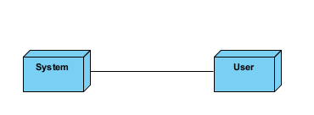
DEPLOYMENT DIAGRAM
Deployment diagram represents the deployment view of a system. It is related to the component diagram. Because the components are deployed using the deployment diagrams. A deployment diagram consists of nodes. Nodes are nothing but physical hardware’s used to deploy the application.

Slide 31
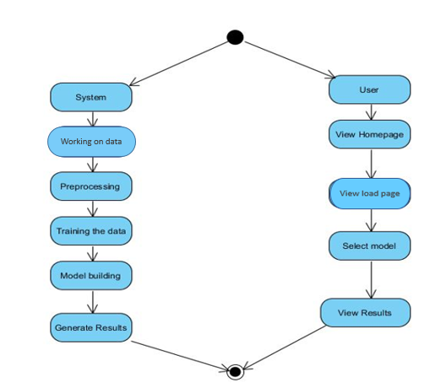
ACTIVITY DIAGRAM:
Activity diagrams are graphical representations of workflows of stepwise activities and actions with support for choice, iteration and concurrency. In the Unified Modelling Language, activity diagrams can be used to describe the business and operational step-by-step workflows of components in a system. An activity diagram shows the overall flow of control.

Slide 32
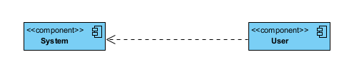
COMPONENT DIAGRAM:
A component diagram, also known as a UML component diagram, describes the organization and wiring of the physical components in a system. Component diagrams are often drawn to help model implementation details and double-check that every aspect of the system's required function is covered by planned development.

Slide 33
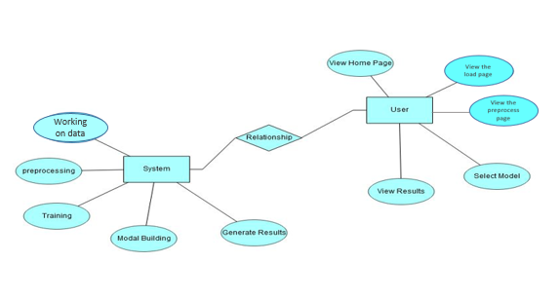
ER DIAGRAM:
An Entity–relationship model (ER model) describes the structure of a database with the help of a diagram, which is known as Entity Relationship Diagram (ER Diagram). An ER model is a design or blueprint of a database that can later be implemented as a database. The main components of E-R model are: entity set and relationship set.
An ER diagram shows the relationship among entity sets. An entity set is a group of similar entities and these entities can have attributes. In terms of DBMS, an entity is a table or attribute of a table in database, so by showing relationship among tables and their attributes, ER diagram shows the complete logical structure of a database. Let’s have a look at a simple ER diagram to understand this concept.

Slide 34
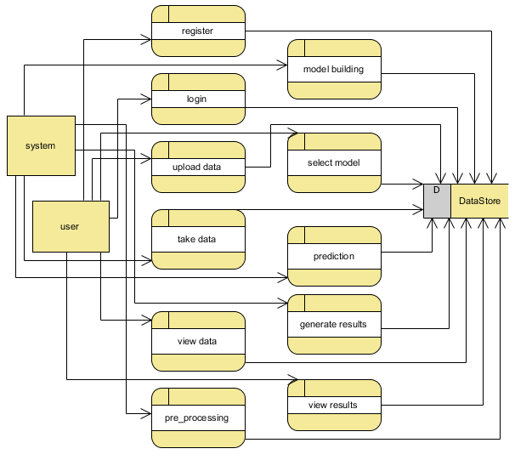
DFD DIAGRAM:
A Data Flow Diagram (DFD) is a traditional way to visualize the information flows within a system. A neat and clear DFD can depict a good amount of the system requirements graphically. It can be manual, automated, or a combination of both. It shows how information enters and leaves the system, what changes the information and where information is stored. The purpose of a DFD is to show the scope and boundaries of a system as a whole. It may be used as a communications tool between a systems analyst and any person who plays a part in the system that acts as the starting point for redesigning a system.

Slide 35
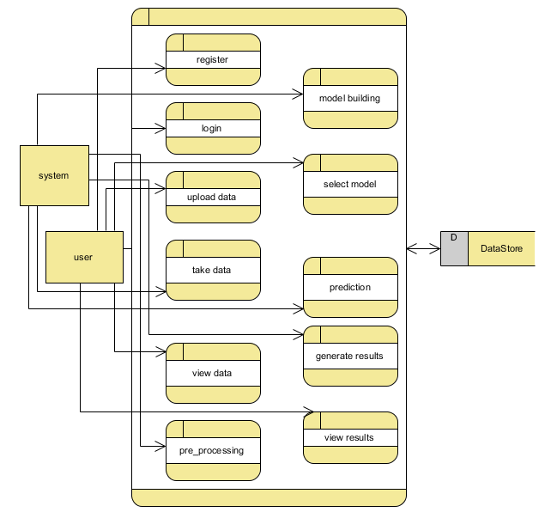

Slide 36
CONCLUSION:
By using AI intelligence we have implemented machine learning techniques through detection of criminal cases and civil cases beyond court analysis here we are going to predicting whether it is a criminal case or civil case,I have implemented random forest,decision tree and logistic regression to get accuracy,based on which algorithm gets best accuracy,we are going to try prediction using input varaibles to get the outcome by using past data predicting the future data. The remainder of the paper is organized into sections. Including the dataset used as well as the analysis techniques used to detect the most important factors influencing crime. This section also includes information about testing the model on a validation database. It concludes the work done, as well as a discussion of future work to create a standard model that can be applied to all datasets. Criminal case materials not only contain a lot of information such as time, place, parties, and description.

Slide 37
REFERENCES:
[1] C. Y. Kim and K. Lee, ‘‘Risk management to cryptocurrency exchange and investors guidelines to prevent potential threats,’’ in Proc. Int. Conf. Platform Technol. Service (PlatCon), Jan. 2018, pp. 1–6.
[2] I. U. Haq, A. Maneengam, S. Chupradit, W. Suksatan, and C. Huo, ‘‘Economic policy uncertainty and cryptocurrency market as a risk management avenue: A systematic review,’’ Risks, vol. 9, no. 9, p. 163, Sep. 2021.
[3] J. Gold and S. D. Palley, ‘‘Protecting cryptocurrency assets,’’ Risk Manage., vol. 68, no. 3, pp. 12–13, 2021.
[4] I. Barkai, T. Shushi, and R. Yosef, ‘‘A cryptocurrency risk–return analysis for bull and bear regimes,’’ J. Alternative Investments, vol. 24, no. 1, pp. 95–118, Jun. 2021.
[5] V. Boiko, Y. Tymoshenko, R. Y. Kononenko, and D. Goncharov, ‘‘The optimization of the cryptocurrency portfolio in view of the risks,’’ J. Manage. Inf. Decis. Sci., vol. 24, pp. 1–9, Sep. 2021.

Slide 38
[6] G. Köchling, ‘‘Essays in finance: Corporate hedging, mutual fund managers’ behavior, and cryptocurrency markets,’’ M.S. thesis, Universitätsbibliothek Dortmund, Dortmund, Germany, 2021.
[7] Z. Umar, N. Trabelsi, and F. Alqahtani, ‘‘Connectedness between cryptocurrency and technology sectors: International evidence,’’ Int. Rev. Econ. Finance, vol. 71, pp. 910–922, Jan. 2021.
[8] T. Kurosaki and Y. S. Kim, ‘‘Cryptocurrency portfolio optimization with multivariate normal tempered stable processes and foster-hart risk,’’ Finance Res. Lett., vol. 45, Mar. 2022, Art. no. 102143.
[9] A. Masharsky and I. Skvortsov, ‘‘Cryptocurrency market development in Latvia and the Baltic states,’’ Eur. Cooperation, vol. 1, no. 49, pp. 7–22, 2021.
[10] S. Bhattacharya and K. Rana, ‘‘A case study on cryptocurrency driven euphoria in 2020-21,’’ Int. J. Res. Eng., Sci. Manage., vol. 4, no. 3, pp. 9–11, 2021.

Slide 39


